Slide 1
The Power of Story: Using Narrative Writing to Improve Student Learning and Success
Jennifer Brooks
Southwestern Community College
November 9, 2021

Slide 2

Humans and Stories
We are storytelling creatures
Ubiquitous (movies, TV, books, families, friends)
Social construction
Personal construction
Popularity of TED Talks or NPR’s StoryCorps
What stories would you share?

Slide 3
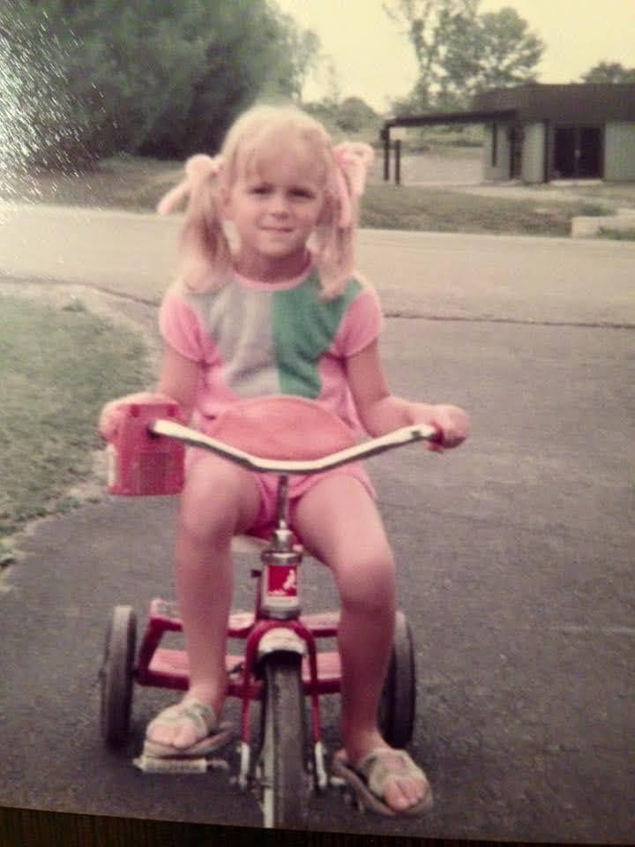
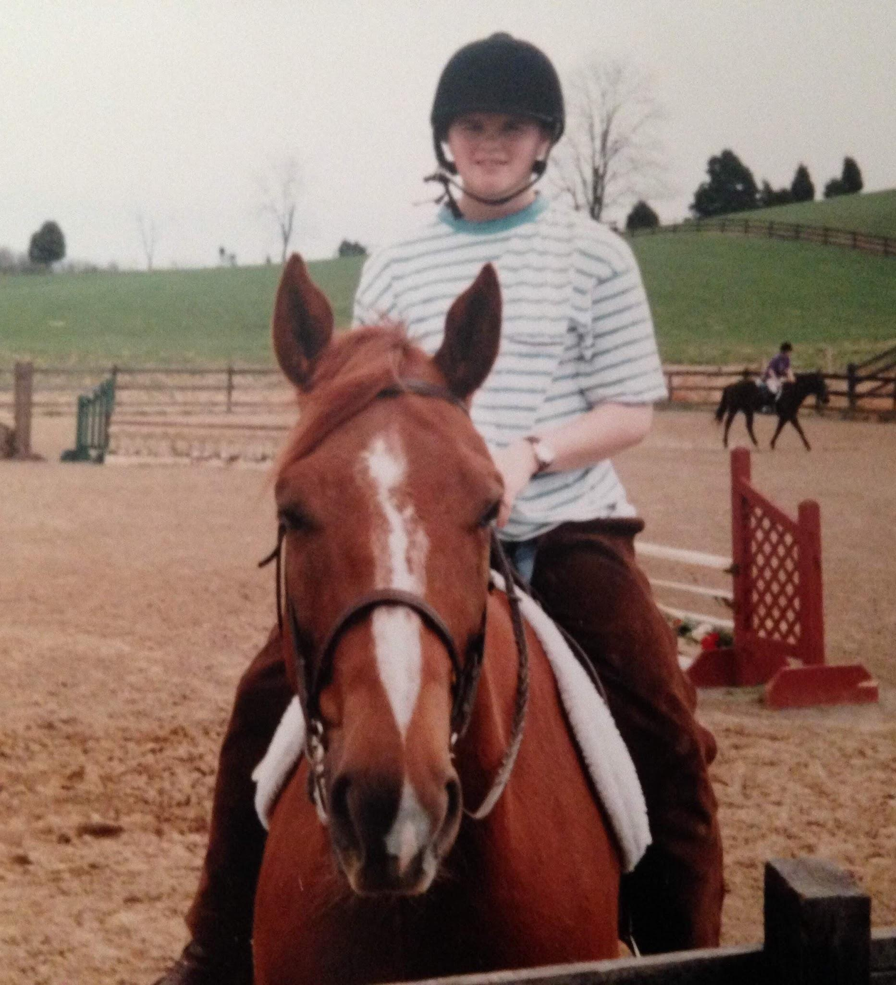
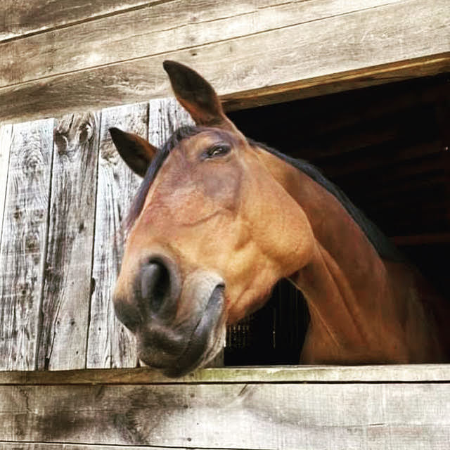
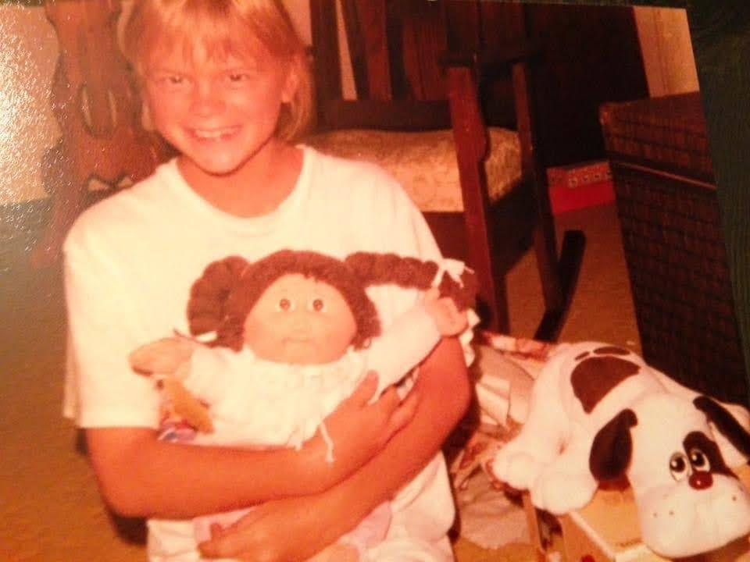
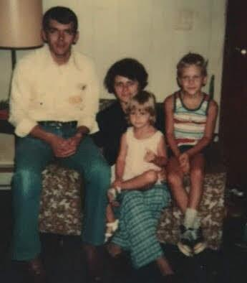
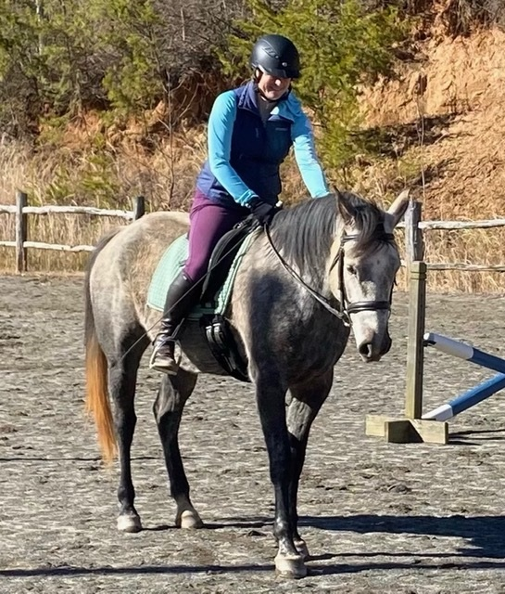

Slide 4

Humans and Stories
We innately seek meaning/connections
We don’t experience the world in separate events
Plot = schema/matrix where events are connected
Narrative activates a pattern we instinctively respond to

Slide 5

Science of Narrative
MBE - Mind Brain Education science
Constructivist theory in learning process
Narrative psychology

Slide 6
“We know only what we can remember at any point.”
Maria Konnikova, Mastermind: How to Think Like Sherlock Holmes

Slide 7

Narrative, Memory, and Learning
Narratives have a grammar, structure
Makes the abstract concrete
Creating narrative requires paying attention
Requires multiple cognitive strategies
Increases student motivation
Uses student’s own voice
Narrative and empathy

Slide 8
Using Narrative Across the Curriculum
“Narrative” doesn’t mean elaborate
A story-like structure of skills, knowledge - a narrative matrix
Clear expectations & rubric set out from beginning
Instructor motivation important, too!
Easy to read and fun to grade
Sample assignments on handout (also posted in shared Google Folder)

Slide 9
An Example from our PTA Program (Susan Kimel)
The Patient’s Story (rubric/checklist in Google Folder)
Three examples of student narratives from this assignment in Folder
Strengths of this assignment:
Supports the purpose of the course (Professional Interactions)
Attention to detail from a different point of view
Increases empathy
Student motivation
Student voice - constructing their learning

